Slide 1
CS 329E: Data Visualization
Junbo Shim
Sagar Patel
May 13, 2015

Slide 2
Class Content
Rstudio
KnitR
Reading data into R
R Graphics: ggplot
Data Wrangling (dplyr and tidyr)
Joining Data
Visualizing Categorical Data
SQL Developer
Loading tables
SQL
Tableau
Continuous vs. Discrete (Green vs. Blue)
Crosstabs
Table Calculations (Rank, Difference, Nth, Percentile)
Blending
Grouping and Sets

Slide 3
Project Data and Location
Data: State Real Estate Data
Median Listing Price
Median Listing Price per Square Foot
Median Sold Price
Median Sold Price per Square Foot
Percent of Homes Selling for Gain
Percent of Homes Selling for Loss
Price to Rent Ratio
Sale Price to List Ratio
Source: Zillow
GitHub: https://github.com/sjb2068/DV_FinalProject.git

Slide 4
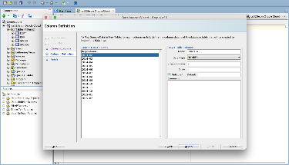
Loading Data to SQL
Download .CSV from Zillow
Import data
Include columns required
Adjust column names
Adjust data types

Slide 5
Building Data Frames
Load libraries in Rprofile.R
Join dataframes using dplyr (inner join)
Melting multiple columns
Adjust column names for visualization

Slide 6
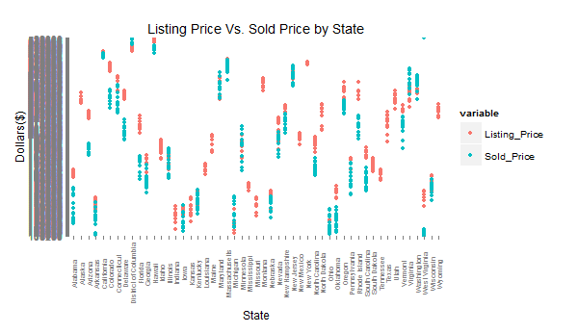
R Data Visualization

Slide 7
R Data Visualization
Data: Listing Price and Sold Price of All states
Operations performed:
Melted Listing Price and Sold Price
Wrangling (filter, inner/outer join)
Axis/Legend Labeling

Slide 8
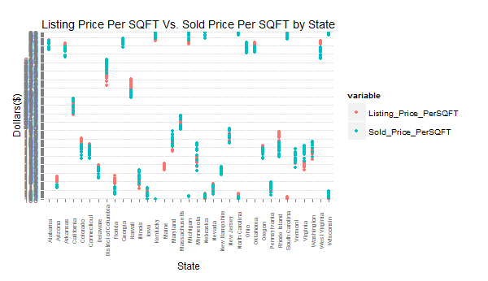
R Data Visualization

Slide 9
R Data Visualization
Data: Listing Price and Sold Price of All states
Operations performed:
Melting Listing Price Per SQFT and Sold Price Per SQFT
Wrangling (filter, outer join)
Axis/Legend Labeling

Slide 10
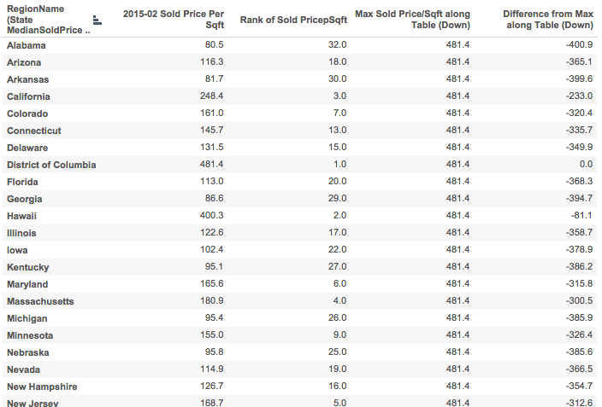
Tableau Data Visualization

Slide 11
Tableau Data Visualization
Data: Houses Sold 2/2015 – Price per Square Foot
Operations performed:
Rank
Max Price per Sqft
Difference from Max Price per Sqft
Table Calculations

Slide 12
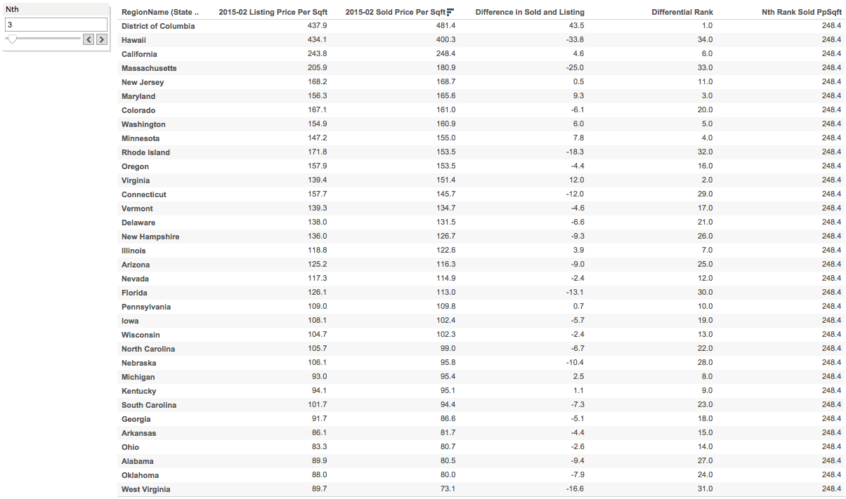
Tableau Data Visualization

Slide 13
Tableau Data Visualization
sdfsdfsdfsdfsdfsdf
Data: Houses Listing and Sold 2/2015 – Price per Square Foot
Operations performed:
Difference between Sold and Listing Price
Differential Rank
Nth Sold Price per Sqft Parameter and Parameter control
Table Calculations

Slide 14
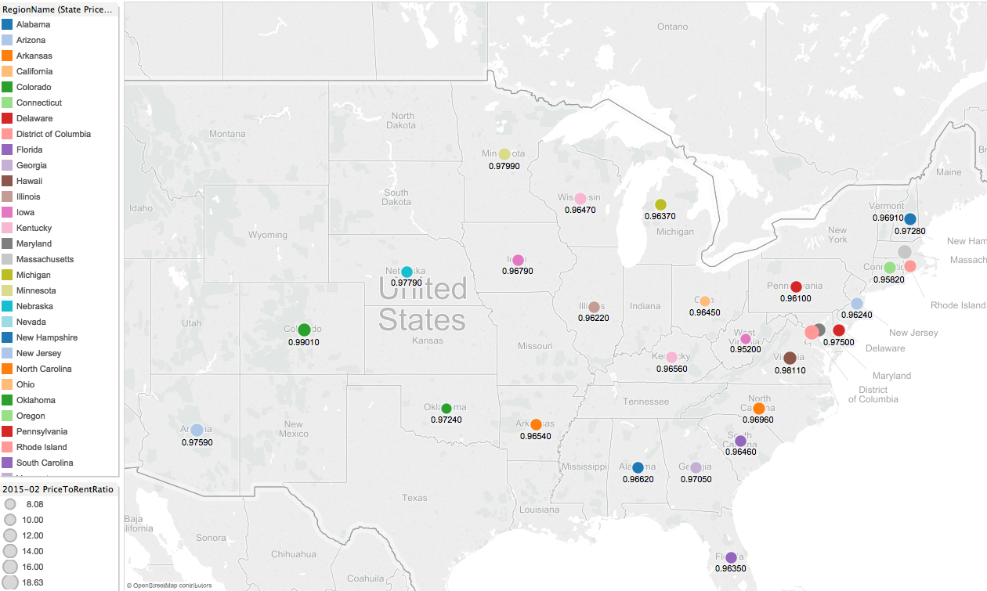
Tableau Data Visualization

Slide 15
Tableau Data Visualization
sdfsdfsdfsdfsdfsdf
Data: House Ratios 2/2015 – Price to Rent and Price to Lease
Operations performed:
Crosstab created
Visual Selected
Size, Color, Label adjusted

Slide 16
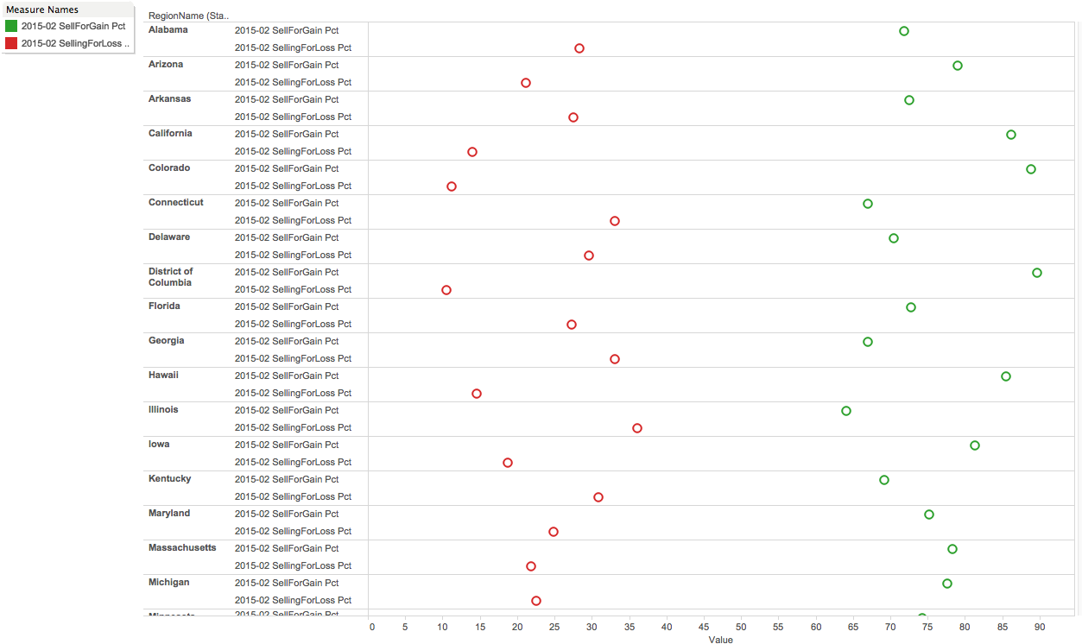
Tableau Data Visualization

Slide 17
Tableau Data Visualization
sdfsdfsdfsdfsdfsdf
Data: Houses Sales 2/2015 – Percent houses sold for gain and percent sold for loss
Operations performed:
Crosstab created
Visual Selected
Columns and rows adjusted
Aesthetics adjusted

Slide 18
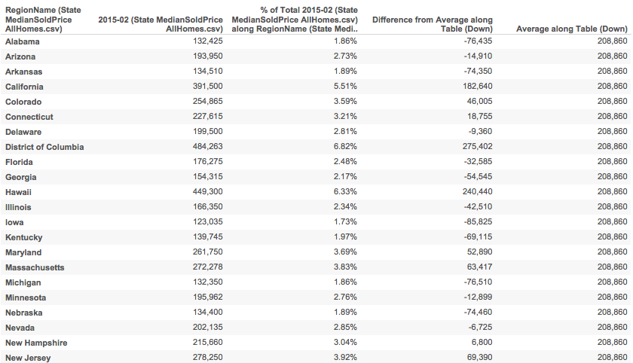
Tableau Data Visualization

Slide 19
Tableau Data Visualization
Data: Houses Sales 2/2015 – Percent houses sold for gain and percent sold for loss
Operations performed:
Crosstab created
Visual Selected
Columns and rows adjusted
Aesthetics adjusted
Data: Houses Sold 2/2015 – Price
Operations performed:
Table Calculations
Percent of total
Average
Difference from Average
Columns, rows selected

Slide 20
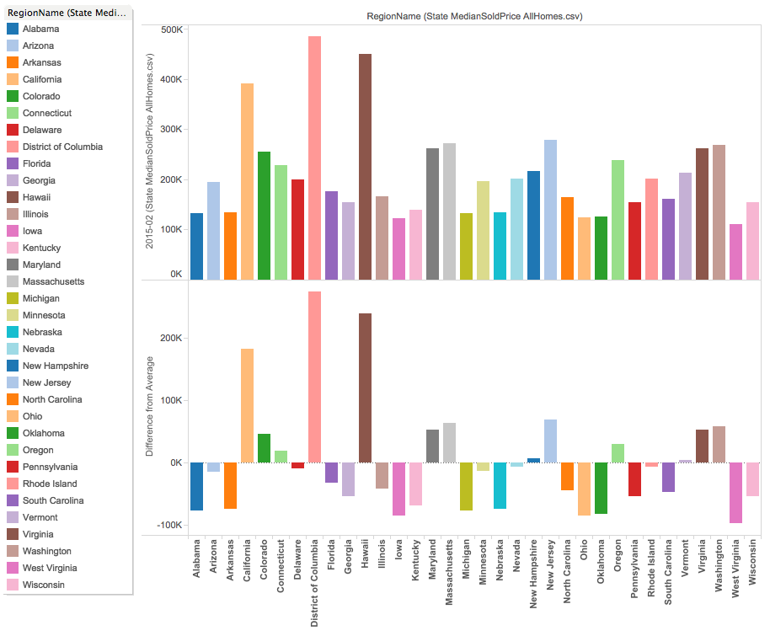
Tableau Data Visualization

Slide 21
Tableau Data Visualization
sdfsdfsdfsdfsdfsdf
Data: Houses Sold 2/2015 – Price
Operations performed:
Table Calculations
Percent of total
Average
Difference from Average
Visual Selected
Columns, rows, and colors selected

Slide 22
Visualization Takeaways
R Visualizations
Tableau Visualizations
Steep learning curve
More power and libraries at your disposal
Reproducibility and Repeatability (R Scripts and KnitR files)
Easy learning curve
Quicker visualizations for pattern finding
Can use once data is edited in SQL Developer/R first

Slide 23
Course Takeaways
GitHub and SourceTree are powerful tools
Meaningful and useable data is hard to find
Reproducibility and Repeatability are extremely important
Experimentation can lead to meaningful conclusions
Research is key

